Slide 1
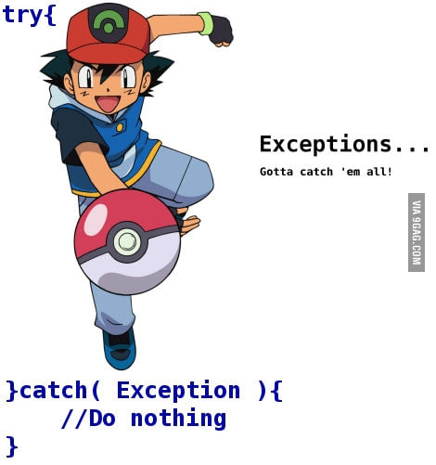
SAROWER AHMMED

Slide 2
Dictionary Meaning: Exception is an abnormal condition.
In java, exception is an event that disrupts the normal flow of the program or methods run flow.

Slide 3
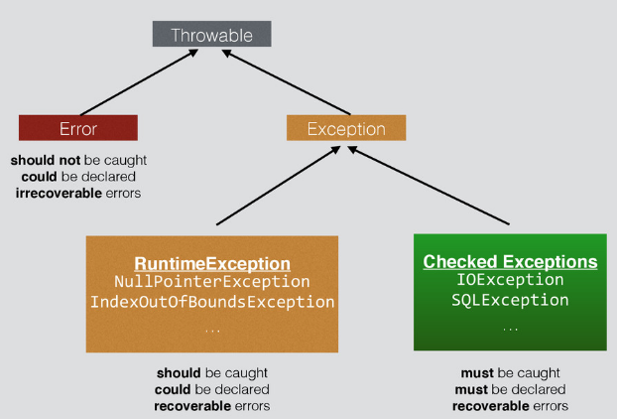
Unchecked Exception or
Compile time Exception or

Slide 4
Wrong code ➔ error
Wrong(logical/java rules) >>> .java >>>>.class➔ compile time exception(Red)
Run test (logical/java rules)➔ runtime exception (no red)

Slide 5
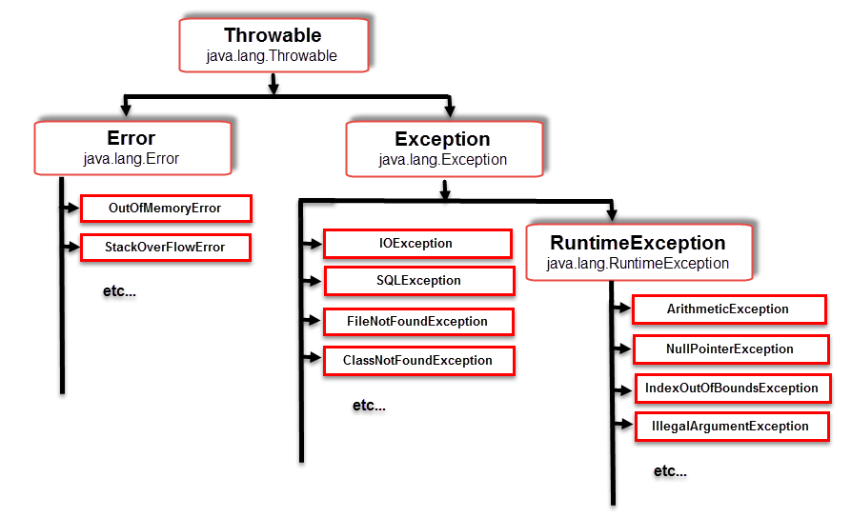

Slide 6
Is it class or interface?
Throwable ➔ class or super class
Exception➔ also class or subclass under Throwable class

Slide 7
Some selenium Exception
NosuchElementfoundexception
StaleElementException

Slide 8
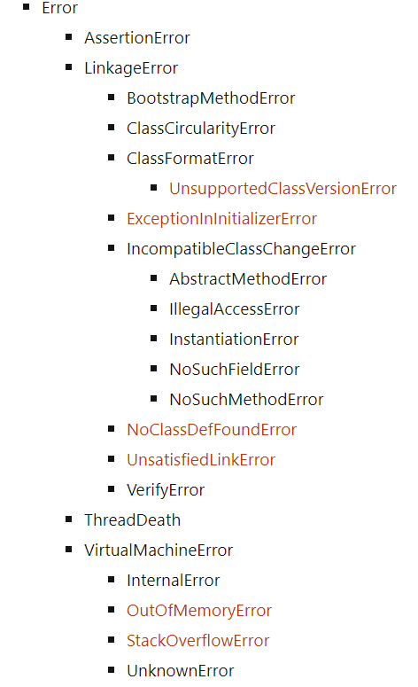

Slide 9
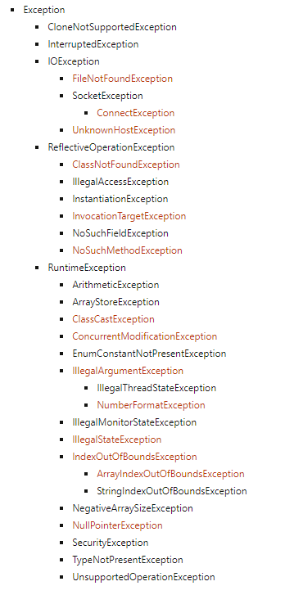

Slide 10
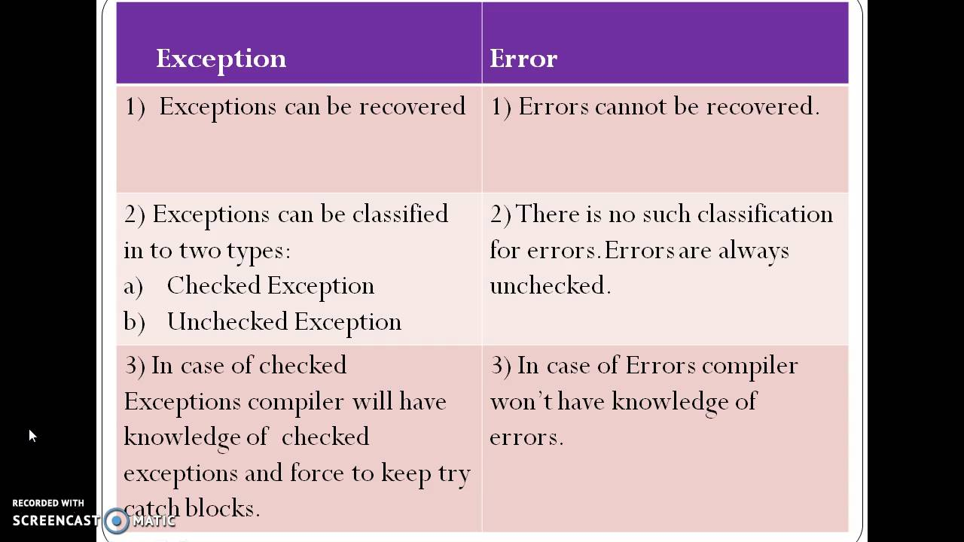

Slide 11
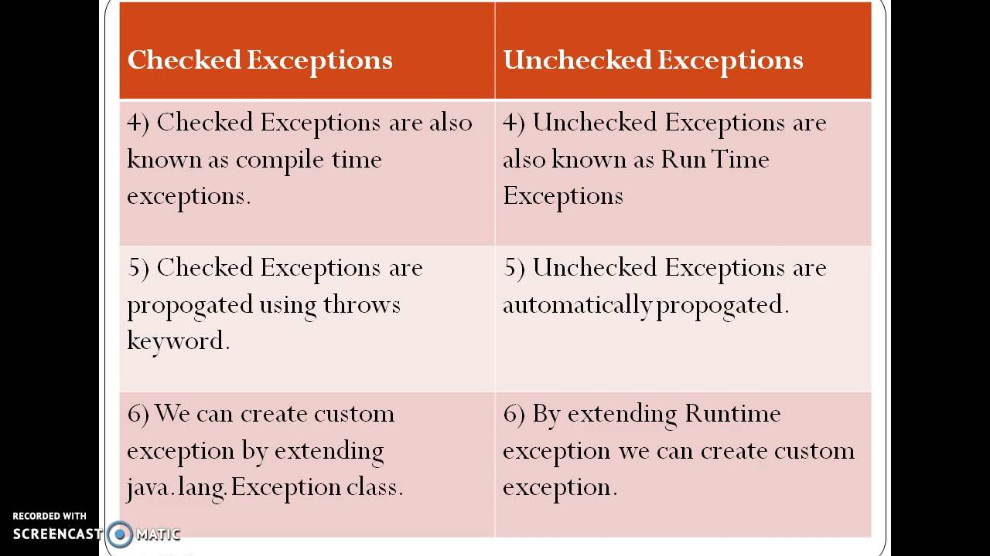

Slide 12
Compile time vs Run Time
Compile time means something happens when you compile the program.
compile time: Developer writes the program in .java format & converts in to the Bytecode which is a class file, during this compilation any error occurs can be defined as compile time error.
Run time means something happens when you run the program.
Run time: The generated .class file is use by the application for its additional functionality & the logic turns out be wrong and throws an error which is a run time error

Slide 13
In Eclipse, compile time errors will be underlined in red.
Common causes for compile time errors include:
Syntax errors such as missing semi-colon or use of a reserved keyword (such as 'class').
When you try and access a variable that is not in scope.
When you declare multiple objects with the same name.
If the compiler detects any errors during compilation it will fail to build a new assembly (or class file in Java).

Slide 14
Even if your code has no compile time errors, errors can still occur on run-time. Errors such as 'logic errors' and 'runtime errors'. A good example of a runtime error is as followed:
Pretend you're going to store an item in an array at index 5 but the array's size is only 4. The compiler won't detect an error here because it understands that the array size is subject to change but on run-time you'll be thrown an exception.
To detect which line exactly a run-time error occurs on you can use a combination of break points in Eclipse and proper exception handling

Slide 15
Try to create some common exception in java
Error ➔ wrong code>>> eclipse will be red color
Exception➔ no red>>>> but if run than it will fail
Checked/ compile time
IOException
Filenotfound exception
SQL exception
Run time or Unchecked
Arethmaticexception
Indexoutofboundexception
Null point exception

Slide 16
Try below code for file not found/ Io exception
public static void ReadExcelData() {
FileInputStream file = new FileInputStream(TestDataPath);
XSSFWorkbook workbook = new XSSFWorkbook(file);
XSSFSheet sheet = workbook.getSheetAt(0);

Slide 17
ClassNotFoundException, SQLException
public class DatabaseForStudent {
public static void main(String[] args) {
Class.forName("oracle.jdbc.driver.OracleDriver");
Connection connection = DriverManager.getConnection("jdbc:oracle:thin:@localhost:1522/orcl", "hr", "sarower");
Statement stmt = connection.createStatement(ResultSet.TYPE_SCROLL_SENSITIVE, ResultSet.CONCUR_READ_ONLY);
ResultSet rs = stmt.executeQuery("select * from employees");

Slide 18
Null point exception
public class CheckNullpointexception {
static String fullName;
public static void main(String[] args) {
System.out.println("Name value::"+ fullName);
String anotherName="sarower";
System.out.println(anotherName.concat(fullName));
}

Slide 19
ArethmaticException
public class ArethmaticException {
static int a;
static int b;
public static void main(String[] args) {
b=10;
int c=b/a;
System.out.println(c);
}
}

Slide 20
IndexOutOfboundException
public class CheckIndexOutOfBoundException {
public static void main(String[] args) {
ArrayList<String> Allname= new ArrayList<String>();
Allname.add("sarower");
Allname.add("Mohit");
Allname.add("Liton");
Allname.add("Sujon");
System.out.println("Array size::"+Allname.size());
for(int i=0;i<Allname.size();i++) {
System.out.println(Allname.get(0));
System.out.println(Allname.get(1));
System.out.println(Allname.get(2));
System.out.println(Allname.get(3));
System.out.println(Allname.get(4));
}

Slide 21
What is exception handling
Exception Handling is a mechanism to handle any exception or runtime errors

Slide 22
Runtime /unchecked handle
By try-catch
By try-with multiple catch
Try-multiple catch with Finally statement
No throws

Slide 23
Compile time/checked handle
To prevent this compile time error we can handle the exception in two ways:
By using try catch
By using throws keyword

Slide 24
Important points to remember about throws keyword:
throws keyword is required only for checked exception and usage of throws keyword for unchecked exception is meaningless.
throws keyword is required only to convince compiler and usage of throws keyword does not prevent abnormal termination of program.
By the help of throws keyword we can provide information to the caller of the method about the exception.

Slide 25
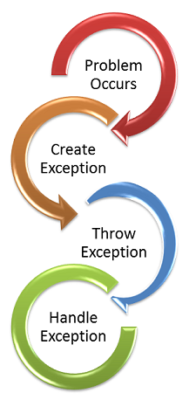

Slide 26
Why java need ?
To maintains the normal flow of the application

Slide 27
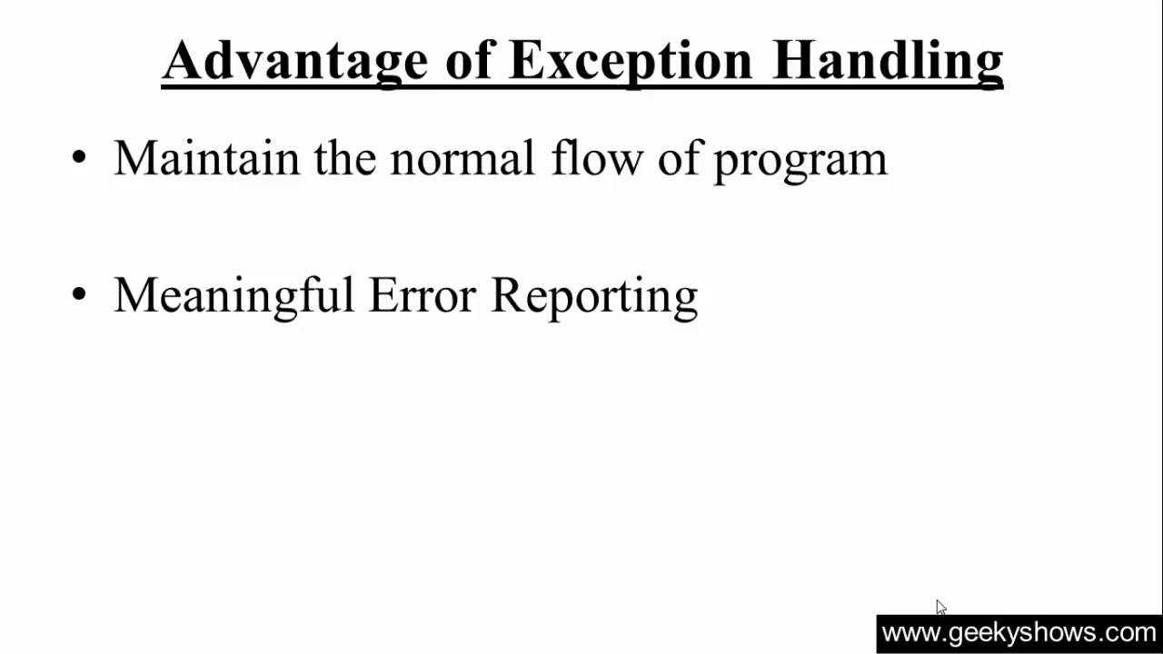
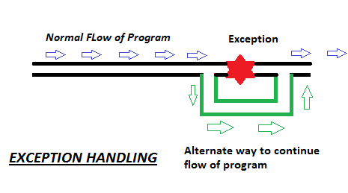
Advantage of Exception Handling

Slide 28
Why need to handle exception
Statement 1;
statement 2;
statement 3; ;//exception occurs
statement 4;
statement 5
statement 6;
If exception not handle than 4/5/6 will not executed

Slide 29
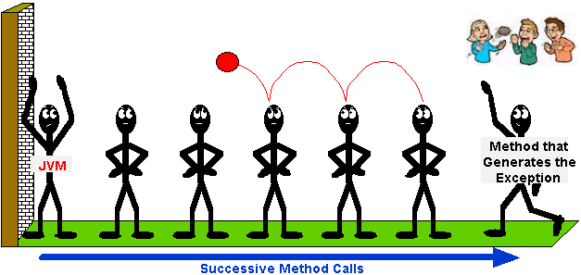
Exception created by method and passing to next methods, all failed

Slide 30
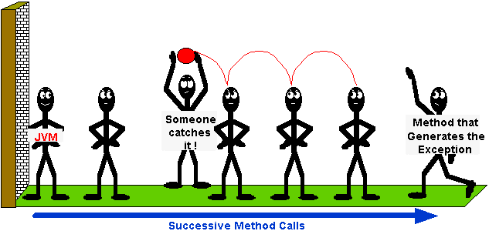
Exception created by method and Cached by one method, so method after catch statement will run.

Slide 31
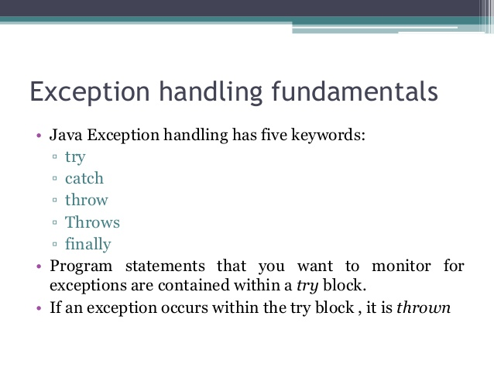
Try catch and throws are almost same

Slide 32

Try Catch

Slide 33
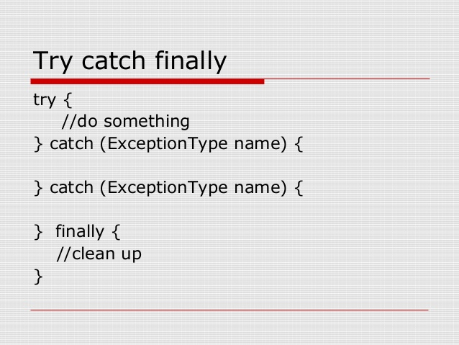

Slide 34
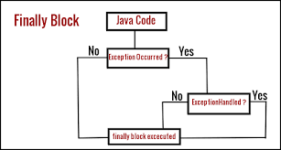

Slide 35
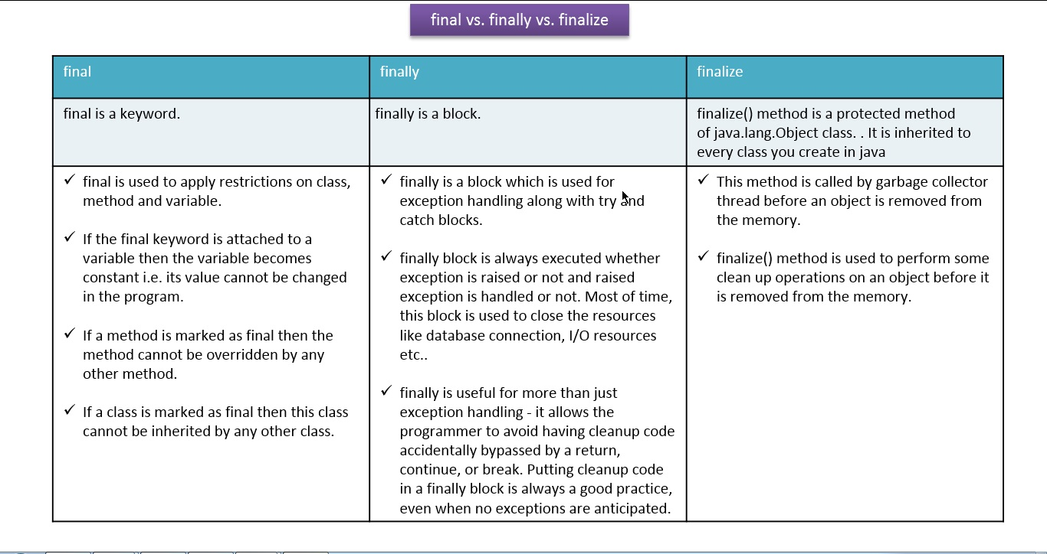

Slide 36
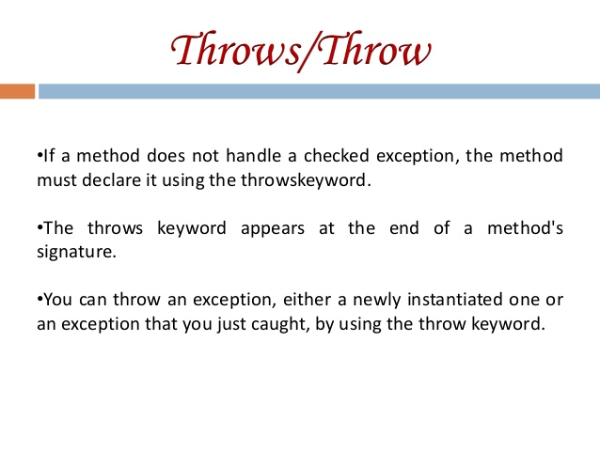

Slide 37
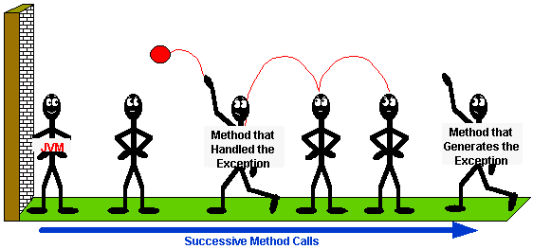
Throws after methods name & throw inside method /try block– when method handle exception and re throw it

Slide 38
throw
Public void getTemperature() throws Exception1, Exception2 {
int temp=50;
// statements...
if (temp > 100) {
throw new too high temperature();
}
// statements...
if (tepm< 0) {
throw new too low temperature();
}

Slide 39
Throw vs Throws
Throw:
void deleteFile(File file) throws FileNotFoundException {
if (!file.exists()) {
throw new FileNotFoundException();
}
file.delete();
}
Throws:
public int myMethod() throws IOException, ArithmeticException, NullPointerException {}

Slide 40
throw | throws
It is used to create a new Exception object and throw it | It is used in method definition, to declare that a risky method is being called.
Using throw keyword you can declare only one Exception at a time | Using throws keyword you can declare multiple exception at a time.
Use inside method body | Use at method signature
Example: throw new IOException("can not open connection"); | Example: throws IOException, ArrayIndexBoundException;

Slide 41

Thanks To All

